Slide 1

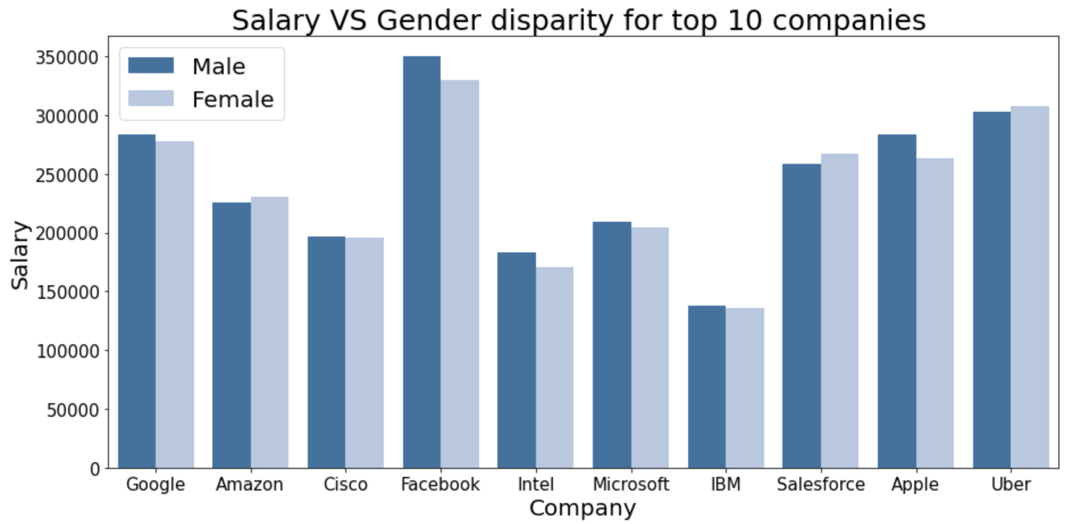
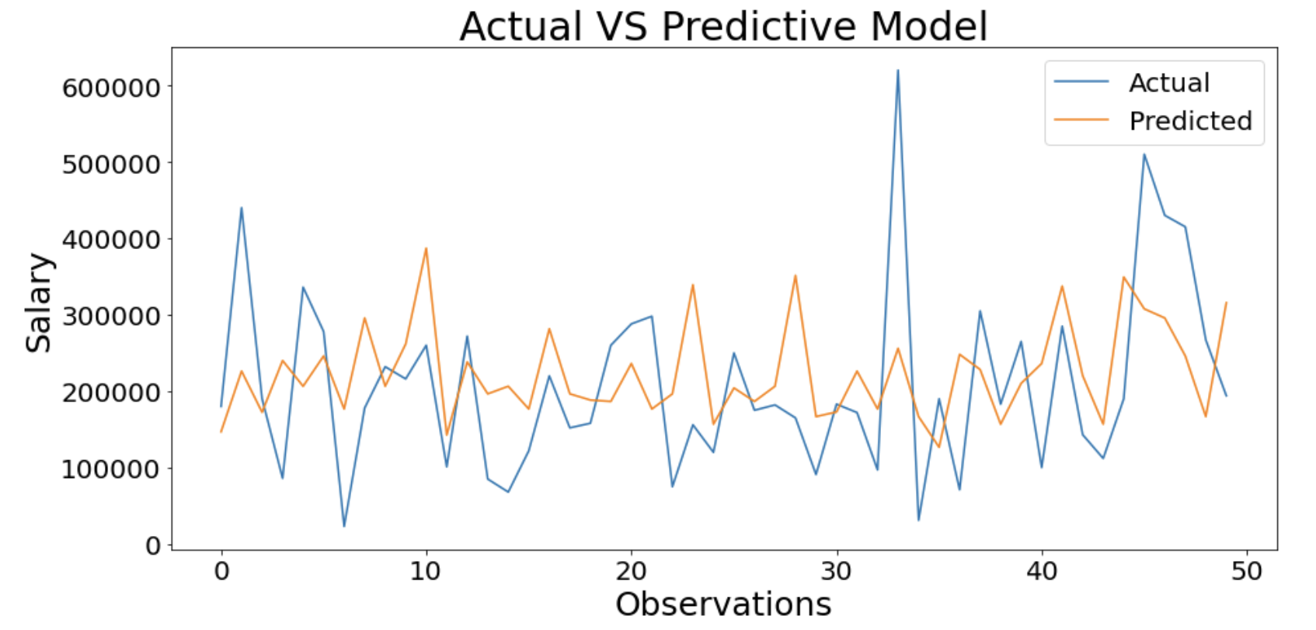
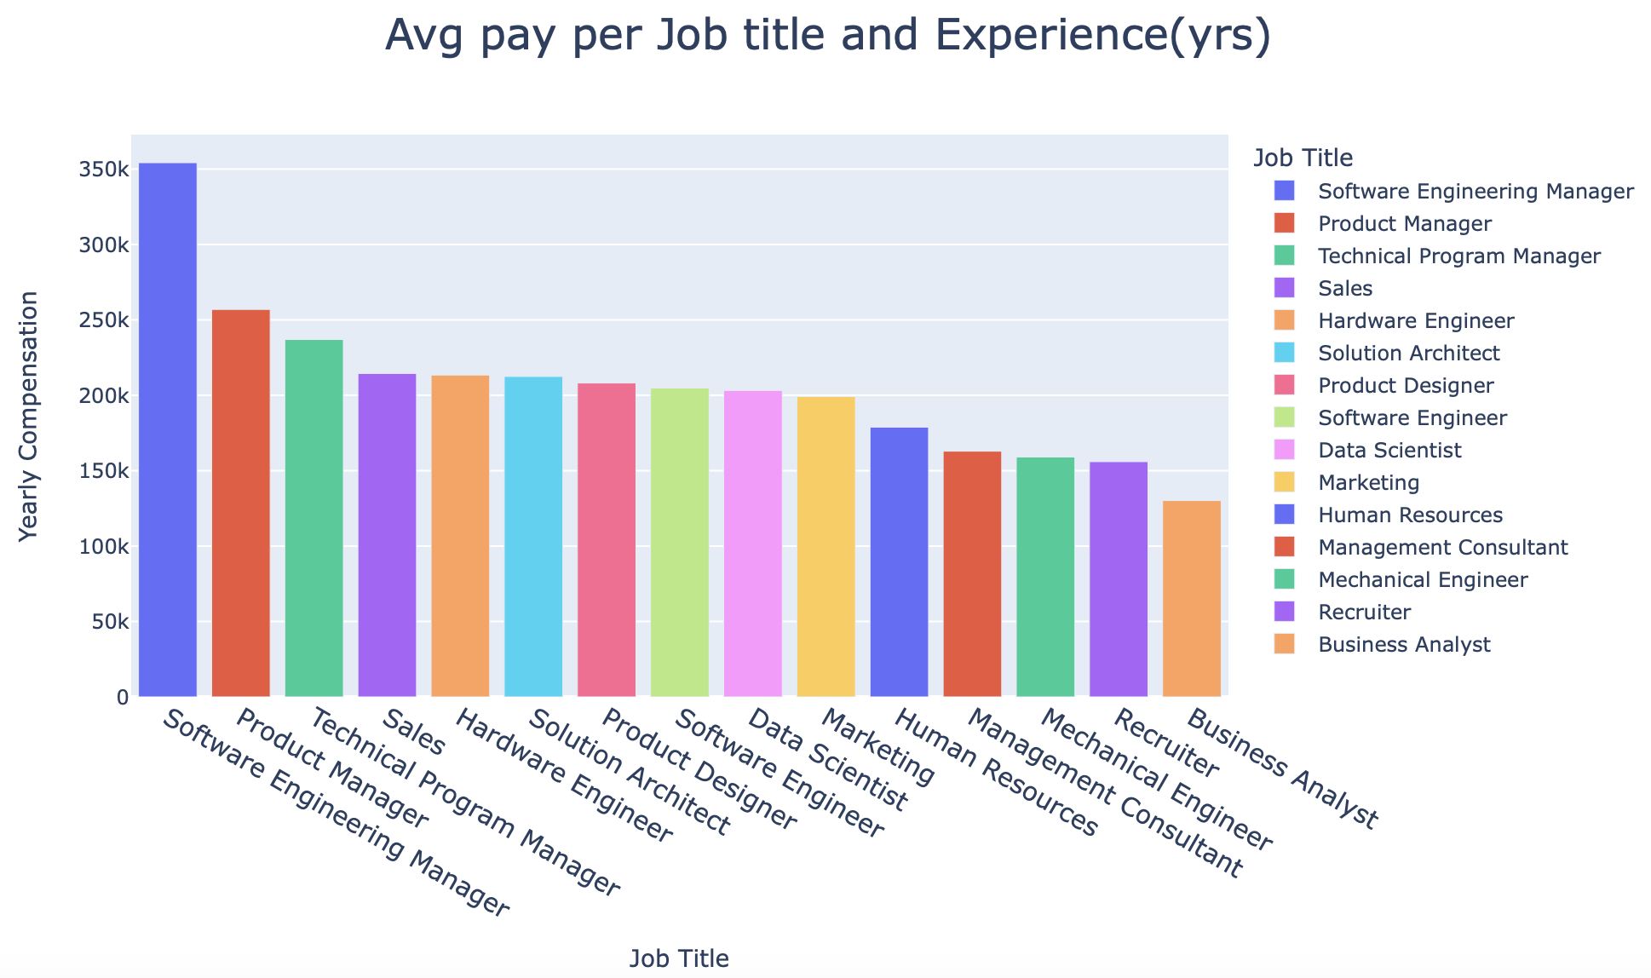
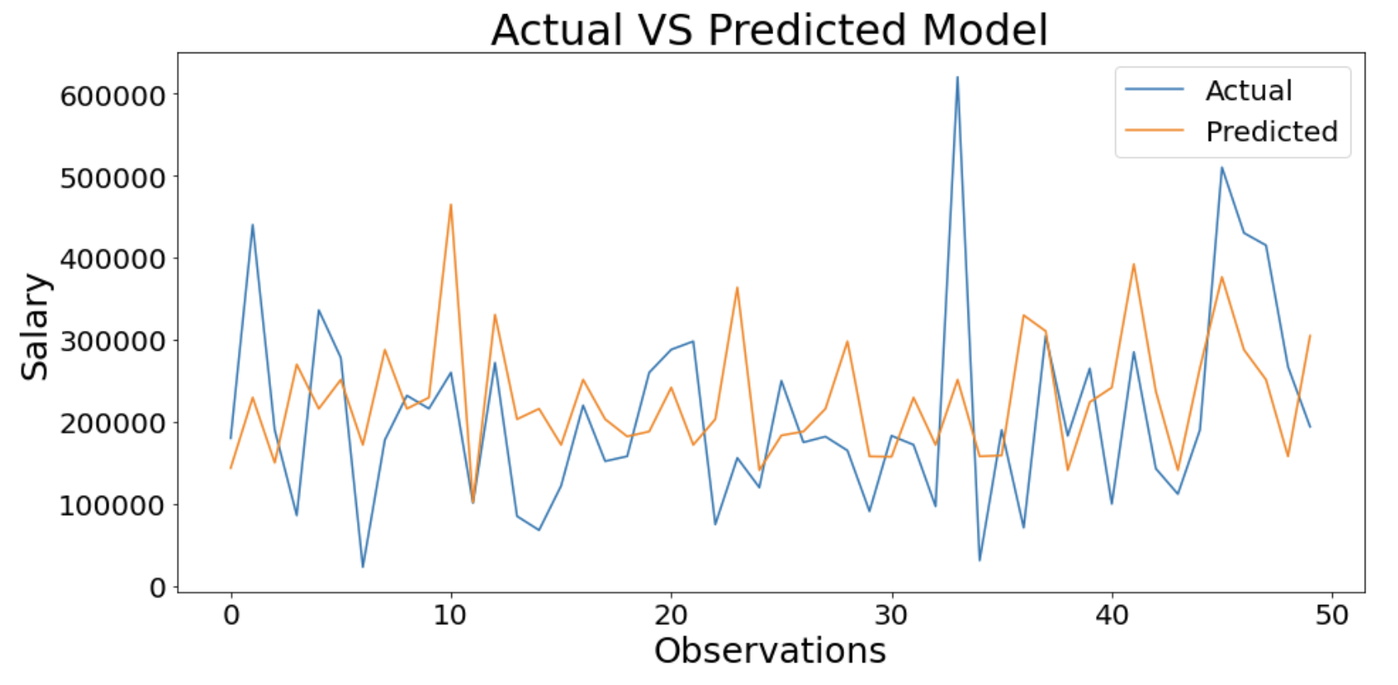
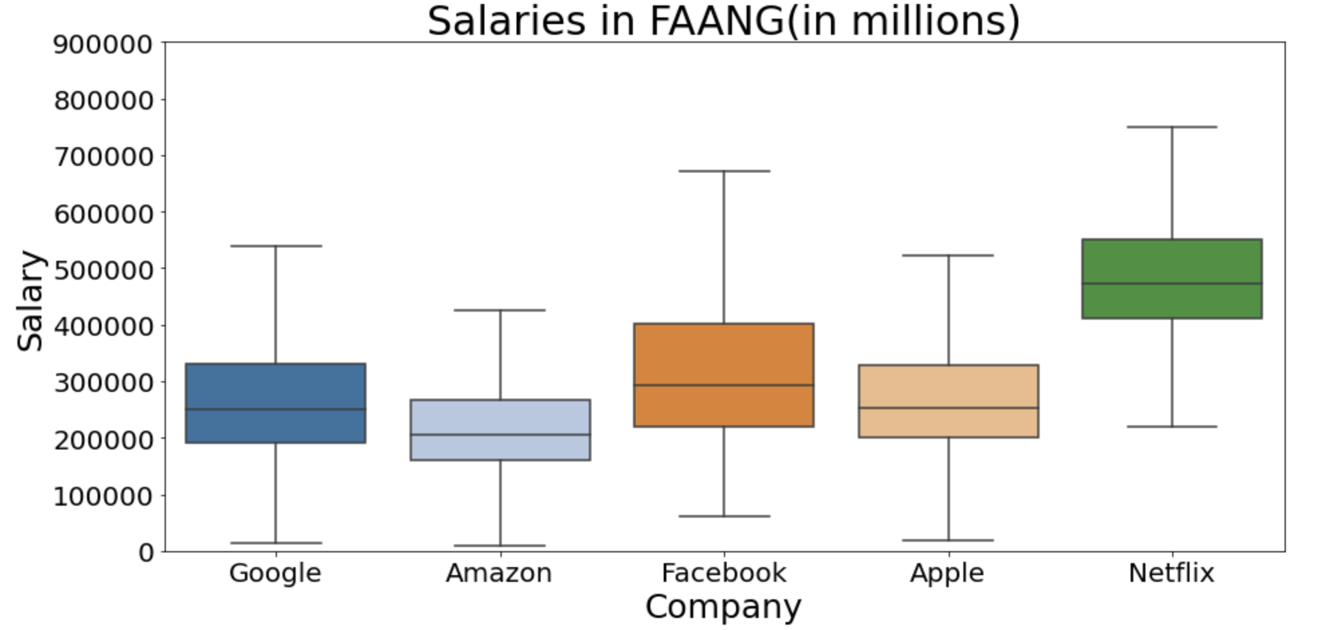
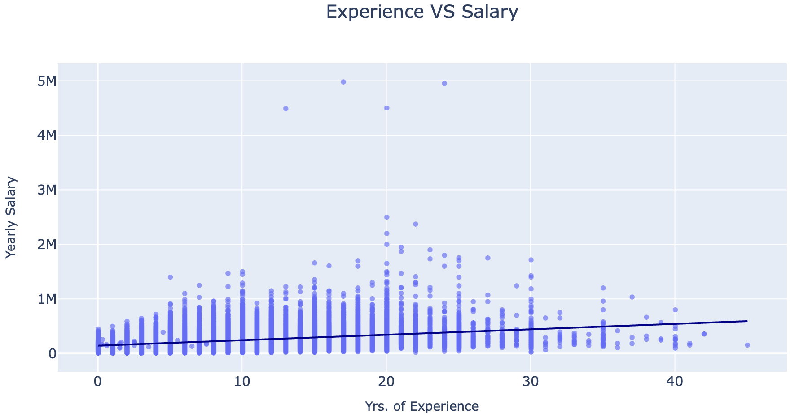
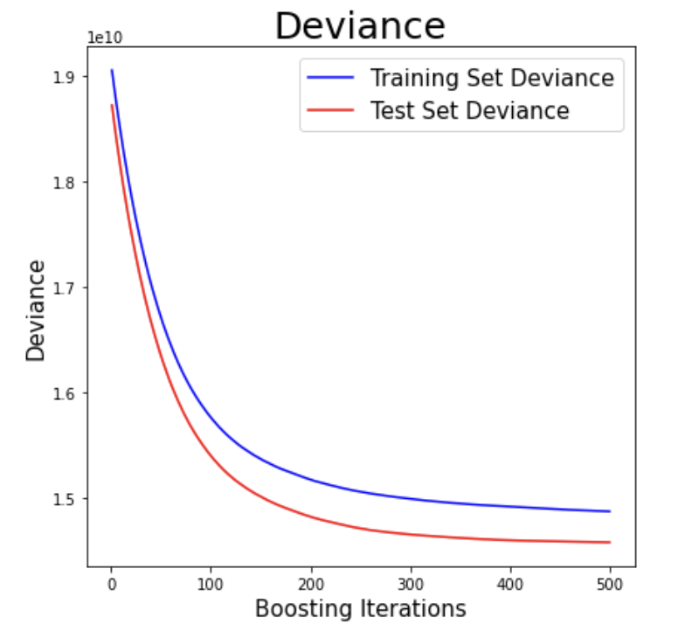
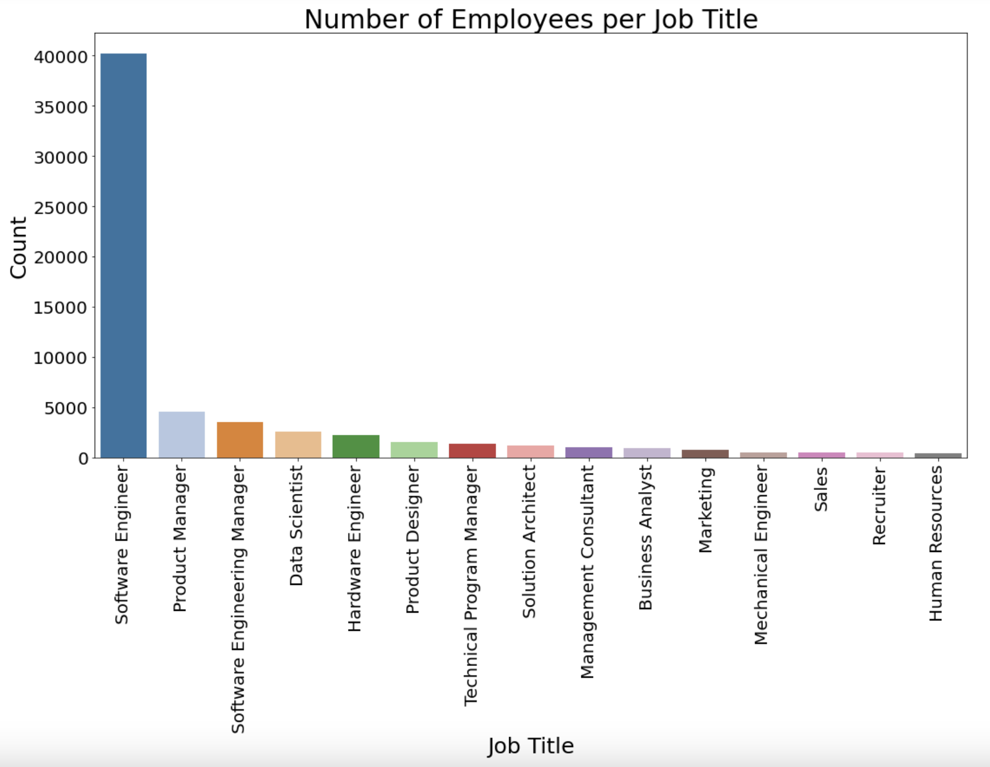
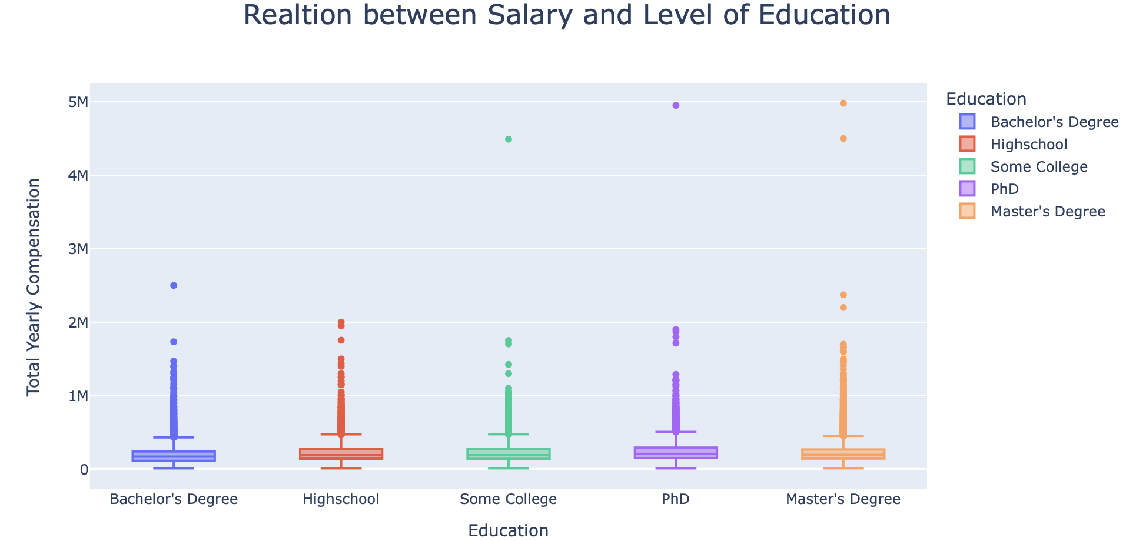
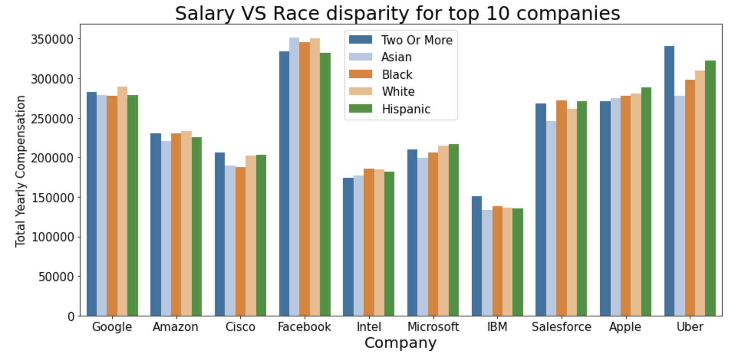

Analysis of STEM salaries
Kunal Pradeep Gandhi
EM 622 – Data Analysis and Visualization Techniques for Decision Making
Introduction:
Surprisingly, there is no direct relation between Salary and Education. Though one thing to note is that with PHD degree, overall, the total yearly compensation is slightly higher than rest of the degrees. Since there is no direct relation between Salary and Education we will not be using Education as one of our modelling parameters. If not education let’s check out compensation with respect to Job title and yrs. of experience.
Turns out, there is no disparity, as there shouldn’t be, with respect to race. There is also no salary disparity with respect to gender.
Predictive Modelling:
Students are always curious about the salaries their STEM degrees can fetch. The purpose of this project is to analyze the total compensation(salaries) based on Gender, Education and Job title for STEM salaries. The objective is to perform EDA and build a predictive model that can predict these salaries.
Linear Regression modelling has been used for predicting our salaries based on Job Title and Years of Experience. Following is the comparison for Actual VS Predictive model. The model has
decently predicted salaries based on years of experience and job title but we will try improving the model using Gradient Boosting Regressor.
Questions Addressed:
1. Is there a relation between salary and education?
2. What is the yearly compensation based on Job title?
3. Is there a relationship between experience and salary?
4. Is there a salary disparity due to Race?
5. Is there a salary disparity due to Gender?
6. What are the typical salaries at FAANG?
7. Which is the hottest job title with respect to number of employees ?
Do not forget to provide insights
After using Gradient Boosting fair amount of adjustments and improvements were made to our predictions, especially in the later half of the graph for some extreme values when compared to our Initial Regression model. The comparison is shown adjacently.
These companies are paying handsomely to their employees. Though, students are always fascinated about the yearly compensation for FAANG companies. Let’s see how much are they paying typically to their employees.
Data Understanding/ Methods:
Data Source: Kaggle
Data Description: The data comprises of 60K+ data points having information about STEM salaries and information on several parameters; gender, race, location, education, stock values, job title, yrs. of experience, level, bonus, stock grant value etc.
EDA Process: The process is divided in 4 phases
Discovery: Familiarizing with data
Cleaning: Removing Null values, mis-spellings, outliers and duplicates
Validating: Verifying if the data is consistent
Analysis: Performing in depth analysis for seeking relationships or trends
Modelling:
1. Structuring the cleaned data set
2. Label Encoding
3. Splitting the dataset into training set and test set
4. Scaling our feature and target variables with respect to their interquartile ranges using Robust Scaler
5. Using regression model to fit the data and make predictions
Now, a Deviance check shows the training and test set deviances as function of the number of boosting iterations. The training set deviance is the deviance of
Manager roles are paid significantly higher than the rest of job roles. Other than Manager roles, 5-8 years of experience in any job role fetches salary above $ 200K. Business Analysts are paid lowest salaries even with 5 years of avg. experience. Here the years of experience and job title does play a significant role in the typical average yearly compensation. Hence Job title will be our modelling parameter. Checking out correlation between number of years and salary would therefore be intriguing.
the model predictions on the training set, while the test set deviance is the deviance of the model predictions on the test set.
A decreasing training set deviance indicates that the model is improving its ability to fit the training data, while a decreasing test set deviance indicates that the model is improving in its ability to generalize to a new unseen data.
Netflix comparatively pays higher salaries than other FAANG companies; over 400K. Google, Amazon, Facebook & Apple typically pay employees well over 150K in total compensation.
Facebook employees have the highest salary range, from 200K to 400K.
Finally, lets check out what job title is the hottest with respect to the number of employees. Turns out, Software Engineer followed by Data Scientist are the hottest job roles.
A large gap between the two curves indicates overfitting, where the model is fitting the training data too closely and not generalizing well to new data. In our case, there is no large gap, indicating efficient fitting where the model is not overfitting the data nor underfitting the data. Hence, the model is decently accurate.
Visualizations:
There is mostly a positive correlation between years of experience and total yearly compensation. Therefore, we will use years of experience as a modelling parameter. Let’s check out for any disparity with respect to race and gender.
Executive Summary:
There is no salary disparity with respect to Race or Gender. Specifically, companies are ready to pay large salaries for Managerial positions. Also, Software Engineer is the hottest job in 2023. Surprising enough, level of education is not indicative of the salary of an employee but the years of experience and the job title is.
Future Work:
The study can be expanded with more data as +60K data points is relatively a small data set. This will enable us to build more accurate models as a sample would be more representative of the population.

